Slide 1


Text Data Processing and Mining
Text Mining
Word Segmentation
ZHANG LunG Lun
艺术与传媒学院 数字媒体系

Slide 2
Outline
Text Mining in Communication Studies
Steps of Text Mining
Introduction to Python
Word Segmentation using Python

Slide 3
Text Mining in Communication Studies

Slide 4
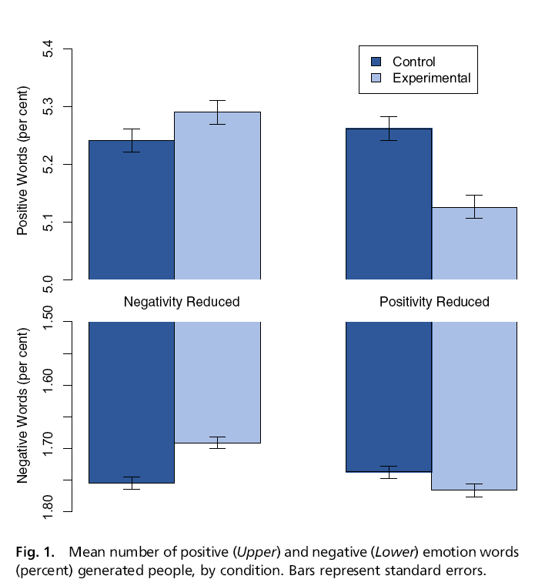
Massive-scale emotional contagion on Facebook
Emotional contagion occurs via text-based computer-mediated communication;
Contagion of psychological and physiological qualities has been suggested based on correlational data for social networks generally
People’s emotional expressions on Facebook predict friends’ emotional expressions, even days later
Kramer, A. D., Guillory, J. E., & Hancock, J. T. (2014). Experimental evidence of massive-scale emotional contagion through social networks. Proceedings of the National Academy of Sciences, 111(24), 8788-8790.

Slide 5
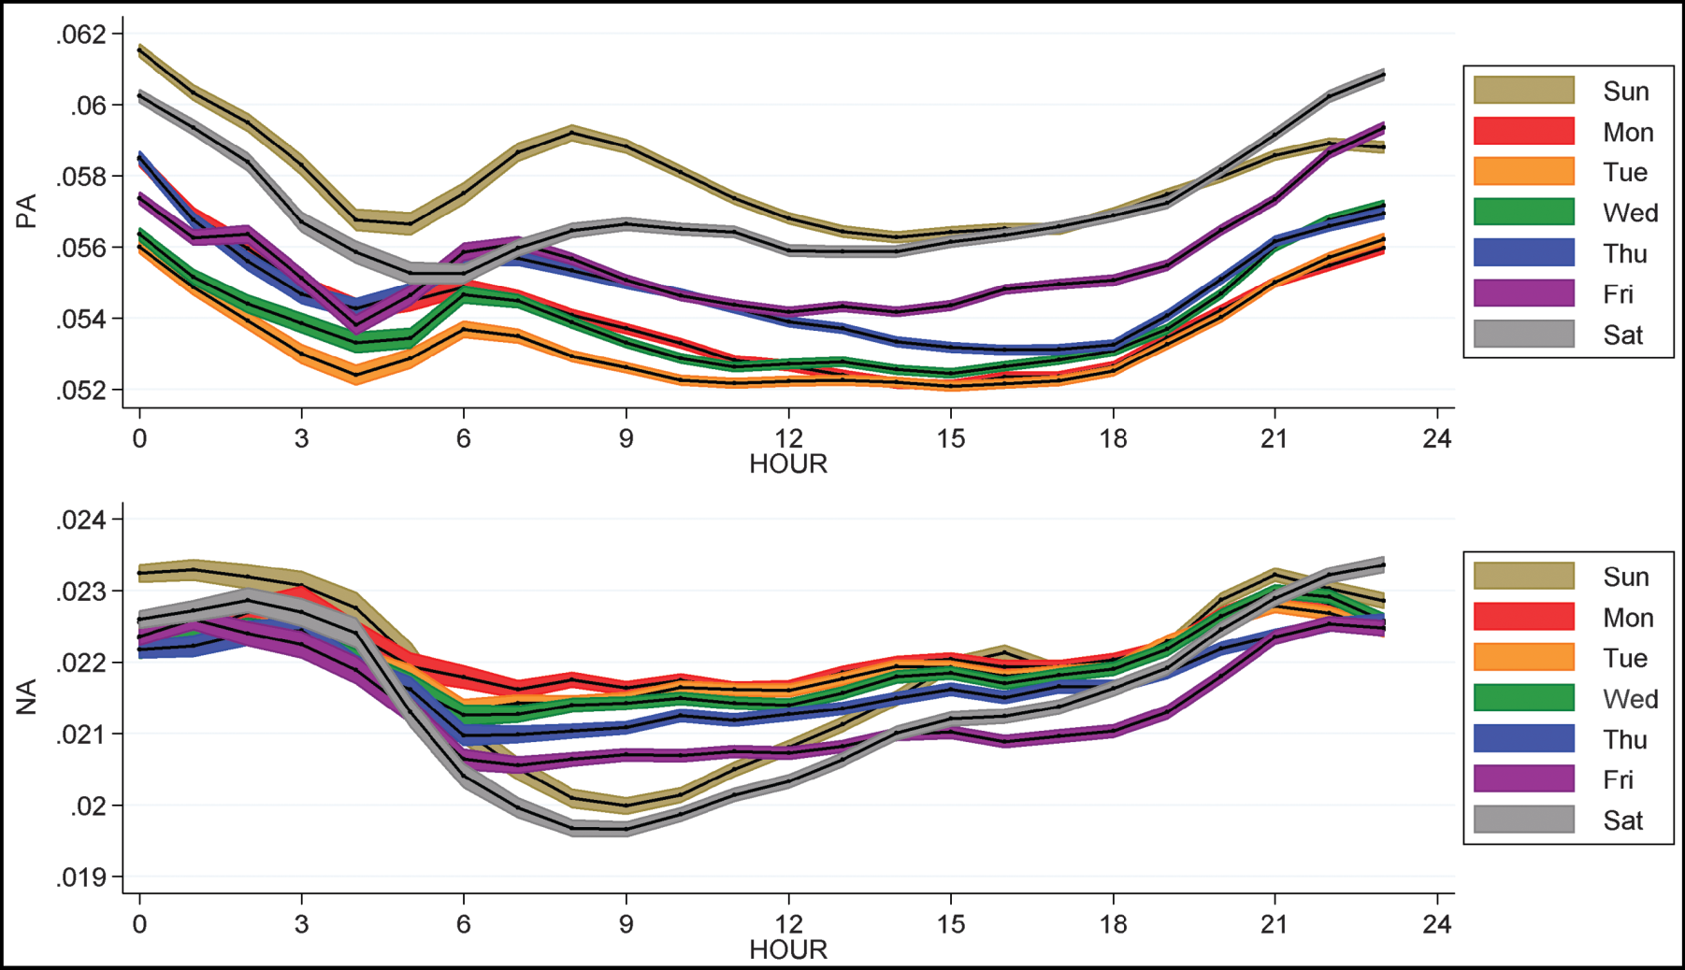
Dynamics of Mood (Golder & Macy, 2011)
Hourly changes in individual affect broken down by day of the week (top, PA; bottom, NA). Each series shows mean affect (black lines) and 95% confidence interval (colored regions).
Notes:
ssumption that PA and NA vary independently and are not opposite ends of a single dimension. NA is neither the mirror image of PA, nor do the two measures move consistently in parallel. This independence is reflected in the small correlation (r = –0.08).

Slide 6
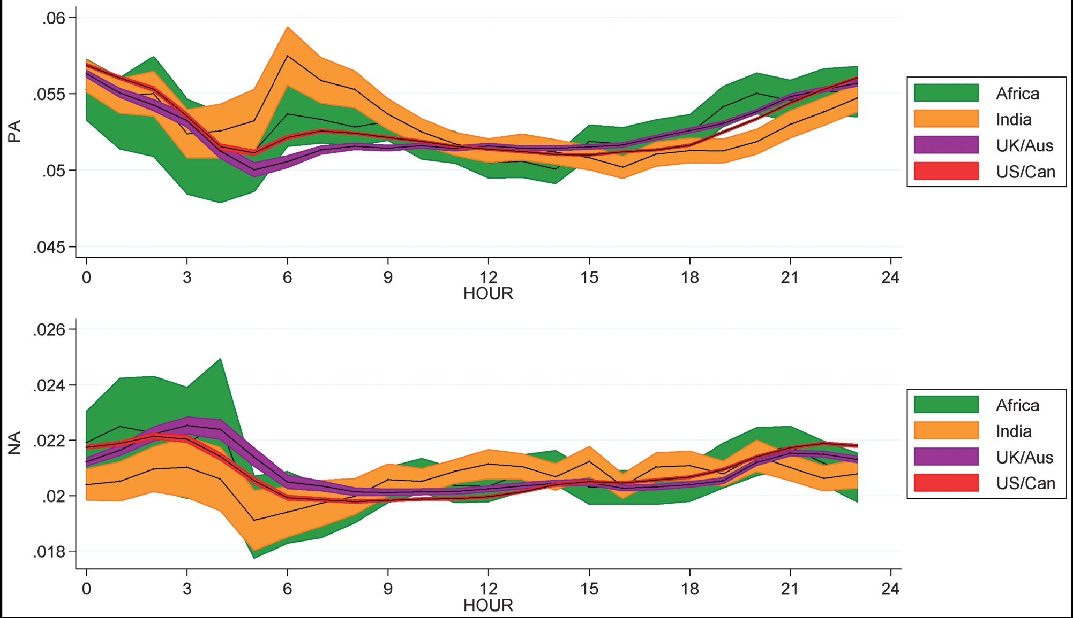
Dynamics of Mood (Golder & Macy, 2011)
Fig. 2. Hourly changes in individual affect in four English-speaking regions. Each series shows mean affect (black lines) and 95% confidence interval (colored regions).
Golder, S. A., & Macy, M. W. (2011). Diurnal and seasonal mood vary with work, sleep, and daylength across diverse cultures. Science, 333(6051), 1878-1881.

Slide 7
Culture Betweenness
Bali et.al。（2016）Predicting。。

Slide 8
Culture Betweenness
Bali et.al。（2016）Predicting。。

Slide 9
Beauchamp.(2015). Predicting and interpolating state-level polls using Twitter Textual Data
To extract the textual features of tweets, the top 10,000 unigrams (including hashtags, urls, etc) were retained,6 and for each state-day unit, the percentage of that unigram in that unit was calculated (eg, 0.02 for “obama” would mean that 2% of all words used in that day in that state were “obama,” at least from among the top 10,000).

Slide 10
Beauchamp.(2015). Predicting and interpolating state-level polls using Twitter Textual Data
Ideology： we test the hypothesis put forward by Gibbs and Cohen (3) of a decline in so-called “Victorian values”. We find that mentions of certain key Victorian values (3) are in overall decline, although terms like “duty,” “courage,” and “endurance” find new impe- tus in times of war, whereas other key terms, notably “thrift” and “patience,” do not exhibit a downward trend, qualifying straight- forward accounts of the supposed demise of Victorian values (Fig. 2A and B).
In United Kingdom politics, Gladstone and Disraeli are often seen as the key political figures of the 19th century; however, our findings suggest that Gladstone was significantly more newswor- thy during the 19th century itself than Disraeli (Fig. 2C). This finding could be partly because of Gladstone’s greater political

Slide 11
Beauchamp.(2015). Predicting and interpolating state-level polls using Twitter Textual Data
Notes:
Our findings also suggest a very clear timeline in the emer- gence of “Britishness” as a popular idea, with the term “British” overtaking the term “English” at the end of the 19th century (Fig. 2 E and F). Thereafter, we see a significant increase in the use of the term British in the first half of the 20th cen- tury, with dramatic increases during both world wars. The term English declined during the same period (and indeed, suffers small dips during World War 1 and World War 2)—to such an extent that the term “Scottish” overtakes it in the late 1940s, suggesting that British replaced English as a default national identifier. Although scholarship suggests that the development of Britishness predates this rise (16), these data suggest that the dominance of Britishness in the popular imagination is a 20th century phenomenon.

Slide 12
Beauchamp.(2015). Predicting and interpolating state-level polls using Twitter Textual Data
Notes:
In technology, we track the spread of innovations in energy, transportation, and communications. In the first area, we observe the steady decline of steam and the constant increase of electric- ity, with a crossing point in 1898 (Fig. 3A). In the area of trans- portation, we observe how trains overtook horses in popularity in 1902, well after the dawn of the railway age that began in the 1840s, showing the cultural significance of horsepower through- out the 19th century (Fig. 3B).
In the area of communications, we examine the rate of adop- tion of the telegraph, telephone, radio, and television, supporting previous findings (1) that observed an ever-increasing rate of uptake of new technologies that culminated with the rapid rise of television (Fig. 3C).

Slide 13
Social change and popular culture. n-Gram trends showing that (A) “unrest” corresponds with well-known periods of social tension, whereas “revolt” corresponds with tension in British colonies; (B) the suffragette movement falls within a delimited time interval; (C) “slavery” includes the movement for abolitionism and the American Civil War, whereas “anarchist” corresponds to the heyday of concern over anarchist direct action before the rise of fascism and bolshevism; (D) the gender gap in mentions of men and women is closing, with women making advances during the two wars; (E) the gender gap is also closing when measured using the pronouns he and she; (F) actors, singers, and dancers begin to increase in the 1890s, rising sig- nificantly thereafter, whereas references to politicians, by contrast, gradu- ally decline from the early 20th century; and (G) football is more prominent than cricket from 1909 on.

Slide 14
Fig. 5. People in history. (A) Replicating the study (1) on famous personalities by occupation using all extracted entities associated with a Wikipedia entry, we found that politicians and writers are most likely to achieve notoriety within their lifetimes, whereas scientists and mathematicians are less likely to achieve fame but decline less sharply.
(B) We computed the probability that a given reference to a person is to a male or a female person. We find that, although males are more present than females during the entire period under investigation, there is a slow but steady increase of the presence of women after 1900, although it is difficult to attribute this to a single factor at the time.

Slide 15
Steps of Text Mining
Part II

Slide 16
Textual Data
Big amount of information is available in textual form in databases and online sources
Manual coding and effective extraction of useful information are not possible
Notes:
Back to the talk. Our target is textual data. There is huge amount of these data online. All over the world, people tweet, post blogs, and send messages every second and every minute. We want to use these data to understand people. But the scale of the data is far beyond the capacity of human labors. That’s why we want to let the machine to mine the text for us, to save the effort.

Slide 17


String manipulations
Class that holds character string in R is “character”
Rule of quotes
‘a character string using single quotes’
“a character string using double quotes”
“The ‘R’ project for statistical computing”
‘The “R” project for statistical computing’
“This “is” totally unacceptable”
‘This ‘is’ also unacceptable’
demo0.R
Notes:
To do this, we start with strings. String is a sequence of characters. In r, there is a class called “character”, which is used to store strings.

Slide 18
A General Framework
Word Extraction
Topic Extraction and Document Classification
Tokenization
No need to TM ☺
Known
Unknown
Dropping common terms
Topic
Feature Selection
Known
Normalization
Category
Unknown
Stemming/
lemmatization
Unknown
Topic
Topic Models
Known
Words Tagging
Naive Bayes Classification
Notes:
String is a sequence of characters. When we call sth strings, our assumption is, the string doesn’t have meaning. Like the state name, it’s just a name, a label for states. Even it has meaning, we don’t care. However, most of the time, we want to understand texts. Then we can’t treat them as strings. The big step from the last page to this page, is from meaningless strings to human language. How do we do this?
I draw a flow chart to show you the steps of text data preprocessing. The left block is named word extraction. It mainly involves the linguistic part of texts. Human language is complex. Based on a vocabulary, we add grammar, tense, and form sentences. The word extraction excludes all the things we added, and reduce texts to vocabularies. The first step is tokenization. It cuts a character sequence into pieces. Then meaningless common terms, like and, or, of, are dropped. Normalization identifies words with similar meanings, like tv and television, fridge and refrigerator. Stemming or lemmatization standardize words of different tense forms. The last step is words tagging. It classifies words based on different standards. After all these steps, human language is reduced to a list of simple words.
We use different techniques when we have different information about the texts. When we know the categories of texts, but don’t know the topics of categories, we use feature selection in upper right corner. When we don’t know the category of texts, but already have a pre-defined list of topics, we can use naive bayes classification in the lower left corner. Last, when both the topics and categories are unknown, we can use topic models to extract the two simultaneously.

Slide 19
Word Extraction
Tokenization
Dropping common terms
Normalization
Stemming/
lemmatization
Words Tagging
Notes:
Now let’s start from word extraction, because it is the basis for topic extraction and document classification. And the first step is tokenization.

Slide 20
1. Tokenization
Chopping up a character sequence into pieces, called tokens.
Input: Seattle is a coastal seaport city.
Output:
Seattle
is
a
coastal
seaport
city
Notes:
Tokenization is chopping up a character sequence into pieces, called tokens.
When you look at this sentence, “Seattle is a coastal seaport city”. It might be obvious for you that the sentence consists of six words. But the fact is not that obvious for the computer. When the sentence is stored in computer, the space is stored as other characters. It is not recognized as a natural separator.
So we need tokenization, to separate the sequence with spaces.

Slide 21
2. Dropping Common Terms
Excluding extremely common and semantically nonselective words (stop words).
and, are, as, at, be, for, from…
Notes:
The second step is dropping common terms.
When we speak or write, we need some words to help us organize other words into sentences. These words represent the grammar part of language, but they per se do not have substantial meanings. In text mining, these words are called stop words. For example… We need to exclude these words from our vocabulary, because they are frequently used, but will not help us understand the topics or classify documents.

Slide 22
3. Normalization
Creating synonym dictionary so that match occurs despite the superficial differences.
USA = U.S.A. = America
Notes:
Then the next step is normalization.
Normalization deals with synonyms. That’s different words with similar meanings. For example, USA, U.S.A., and America all refer to the same country, although they are different words. Normalization ignores the superficial differences, and put synonyms together. Usually, this step is practiced based on some synonym database or we can build the synonym list manually.

Slide 23
4. Stemming and Lemmatization: Aim
Reducing related forms of a word to a common base form.
Notes:
Stemming and lemmatization both deal with different forms of words. But they are two different approaches.

Slide 24
4. Stemming and Lemmatization: Two Approaches
Stemming: chopping off the ends of words according to some rules to remove the derivational affixes.
Lemmatization: using a dictionary to match a word with its base (lemma).
Rule Example
SSES → SS caresses → caress
IES → I ponies → poni
SS → SS caress → caress
S → cats → cat
does->be women->woman went->go
Notes:
Stemming does not need a pre-defined dictionary. It chops off the end of words according to some rules. Because most of the time, words are based on root, and different forms just add suffix to the root. For example, one rule is that when the end of a word is “sses”, the “es” will be chopped off. And “caresses”, which means “kiss” is cut as caress. Other examples….You may notice that after stemming, some of the words are not complete. You may need to guess the words based on the incomplete part. The advantage of stemming is that it does not need any pre-defined dictionary. Thus it can deal with all words, even newly occurred popular words created by netizens.
The rules of stemming are set by linguistic scholars. Actually, it is a specialty in linguistics. But we will not go that deep into all the details.
Lemmatization takes a different approach towards the problem of different forms of words. It relies on a pre-defined dictionary. You can see that, lemmatization can recognize totally different forms, like went is the past tense of go. Stemming can never transform went into go. Because the transformation is not based on adding suffix.
Similarly, does and be, women and woman are not suffix-based pairs, and can only processed by lemmatization. What’s more, lemmatization keeps words complete. You don’t need to guess the words.
However, the advantage of lemmatization is also its disadvantage. It’s restricted by the dictionary. Therefore, when words beyond the dictionary occurs in texts, lemmatization cannot deal with it.

Slide 25
5. Words Tagging: Aim
Marking up a word, based on both its definition, as well as its context, often requiring context-specific dictionaries.
Notes:
The last step of word extraction is words tagging.
Words tagging, literally, mark words with tags. Actually, it classifies words into different categories. And when we want to extract something from the words, we deal with different categories differently.
There are various kinds of word tagging

Slide 26
5. Words Tagging: Grammatical Tagging
Known as part-of-speech tagging (POST).
Word Tag
heat verb (noun)
water noun (verb)
In prep (noun, adv)
a det (noun)
large adj (noun)
vessel noun
Notes:
Grammatical tagging is the most frequently used one. It marks words based on its grammatical function. For example, based on different context, heat may be marked as verb or noun. Other examples…Grammatical tagging is widely known as part-of-speed tagging, post. Because it marks up a word according to a particular part of speech.
It is also a specialty in linguistics and machine learning. We will not go deep into this specialty. But I’d like you have a look at one tagging system, developed by a lab in the university of Pennsylvania.

Slide 27
5. Words Tagging: Named Entity Tagging
Word Tag
2010 date
Obama person
Seattle location
WTO organization
Notes:
There are other tagging systems, like named entity tagging.

Slide 28
Exercise: Your First Word Extraction Task
tm provides a comprehensive text mining framework for R. The Journal of Statistical Software article Text Mining Infrastructure in R gives a detailed overview and presents techniques for count-based analysis methods, text clustering, text classification and string kernels.
tm | provid | comprehens | text | mine | framework | r | journal | statist | softwar | articl | text | mine | infrastructur | r | give | detail | overview | present | techniqu | countbas | analysi | method | text | cluster | text | classif | string | kernel

Slide 29
Getting Started with Python
Part II

Slide 30
Installation & Activation
Installation
Anaconda – spyder
Activation
Mac “Terminal-spyder”
Windows “Cmd-spyder”
Or
“Anaconda”
Ref: 《First Python Notebook Documentation 》

Slide 31
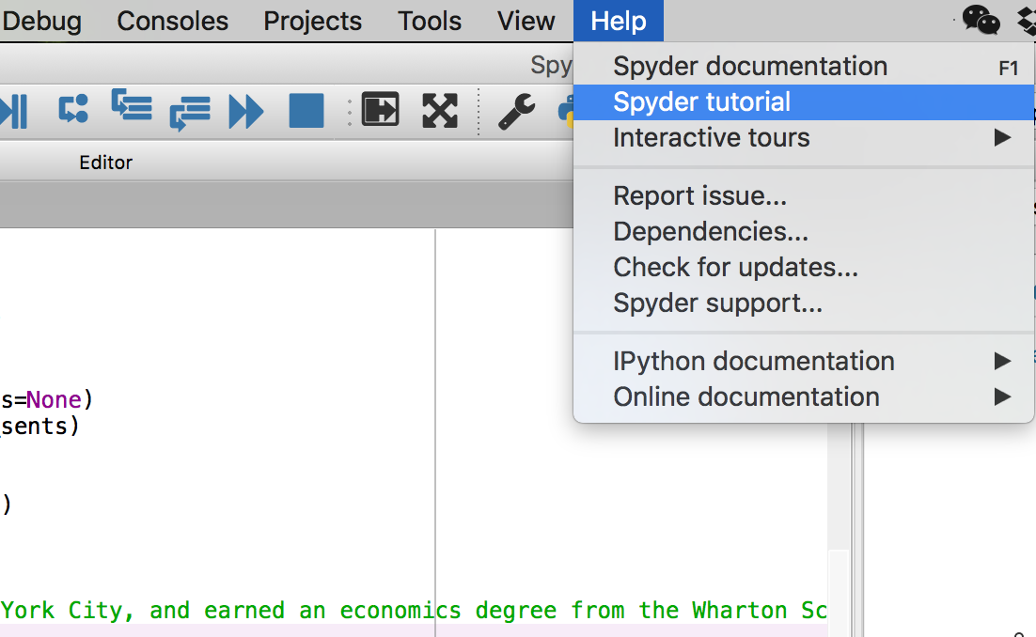
What is Spyder?
Spyder is an Integrated Development Environment (IDE) for scientific computing using the Python programming language
Console, Editor, Environment

Slide 32
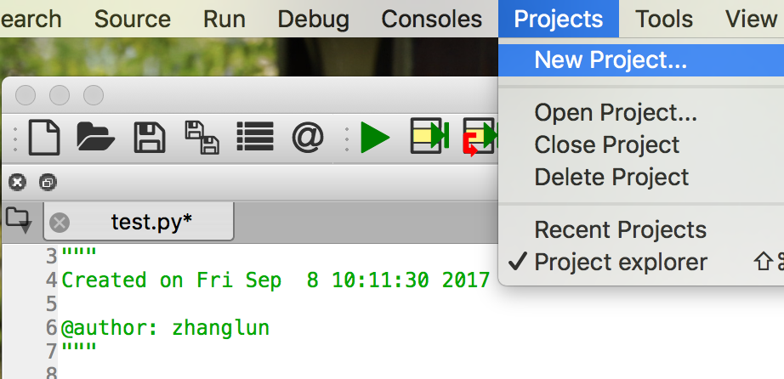
Setup before Programing
Working Directory:
import os
os.getcwd()

Slide 33
Of the First Importance!
Best Teacher for Learning Python：
Google, Youtube, Github, Stackoverflow
Not your peers or teachers!
Why？
Best way to learn Python(or any other programing):
Task Oriented! （Not read the 1000 pages manual）why?
Trial & Error！
Practice, Practice, Practice.

Slide 34
Preparation
Install packages
nltk
nltk.download()
import nltk
import string
import re
Notes:
Let’s initiate r and install packages.
We continue to use R today. But I want you to focus on the content instead of coding. I put all the codes in the demo files. I just want you to follow me, read the codes, execute them, do some minor revisions, and observe the results. You don’t need to do much typing. Theoretically, you won’t get as many error messages as before, since the codes are all there for you. But if you encounter error messages, what should you do? My suggestion is “let it go”. Today I become the speaker, so we don’t have helpers walking around anymore. You should focus on the talk instead of error messages. You can study them when you go back home, and you’ll benefit more.

Slide 35
Word Segmentation with Python
Part IV

Slide 36
What can you do next?
Causality
Generalized Linear Model (e.g., ANOVA, MANOVA)
Regression
Trends or Temporality
Regression
Time Series Analysis (ARIMA or Vector-autoregression)
Structure
Network Analysis

Slide 37
Readings
Required:
Grimmer, J., & Stewart, B. M. (2013). Text as data: The promise and pitfalls of automatic content analysis methods for political texts. Political Analysis, 21, 267-297.
Feinerer, I. (2013). Text mining in R. [R package, http://cran.r-project.org/web/packages/tm/vignettes/tm.pdf ]
Grun, B., & Hornik, K. (2011). Topicmodels: An R package for fitting topic models. Journal of Statistical Software, 40(13), 1-30. [R package, http://cran.r-project.org/web/packages/topicmodels/vignettes/topicmodels.pdf ]
Optional:
Jiang, L. C., Wang, Z. Z., Peng, T. Q., & Zhu, J. J. H. (2015). The divided communities of shared concerns: Mapping the intellectual structure of e-Health research in social science journals. International Journal of Medical Informatics, 84(1), 24-35.
Bisgin, H., Agarwal, N., & Xu, X. (2012). A study of homophily on social media. World Wide Web-Internet and Web Information Systems, 15(213–232).
Zhao, W. X., Jiang, J., Weng, J., He, J., Lim, E. P., Yan, H., & Li, X. (2011). Comparing Twitter and traditional media using topic models. In Advances in Information Retrieval (pp. 338-349). Springer Berlin Heidelberg. [Same as optional reading 3 of lecture 1]

Slide 38
R vs. Python
R: a computation tool that can do programming.
Array-oriented syntax
Strong support from the statistical community
Python: a programming (or scripting) language that can do computation.
High speed
Code readability

